Slide 1
BM CARGO
Berk Sebit-11916039
Mehmet Ali Özkaya-11952033

Slide 2
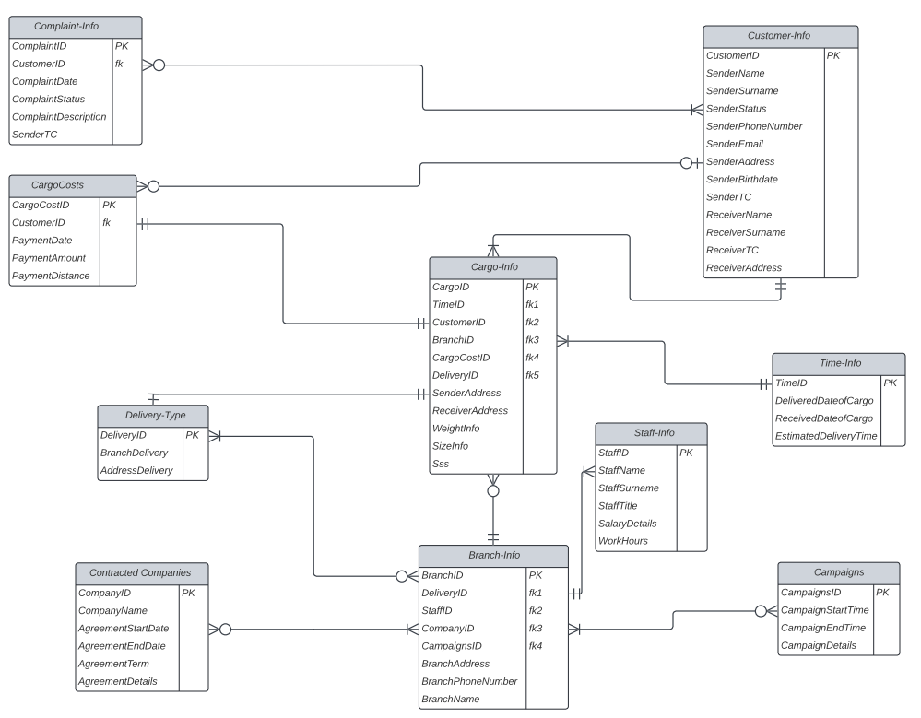
Database Design

Slide 3
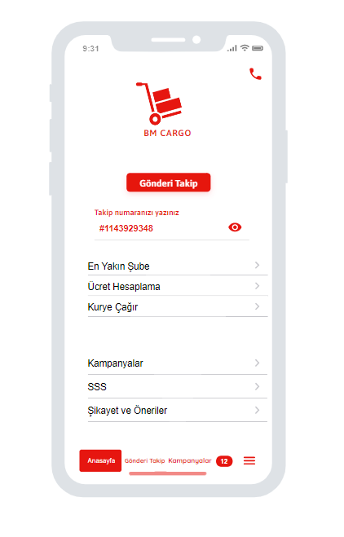
Home Page
From here, quick access to BM Cargo customer service is provided.
SELECT CargoID * FROM Ca bmCargo_db.Cargo-Info WHERE `CargoID ` == #1143929348(user’s input);;
We check the customer's cargo is on our database. If the cargo is in our database, redirected to the page with shipping information. If it isn't in our database, message will appear stating that there is no such cargo.
The customer directs it to other interfaces from here to perform the desired action.
From here, short and quick access to other pages is provided.

Slide 4
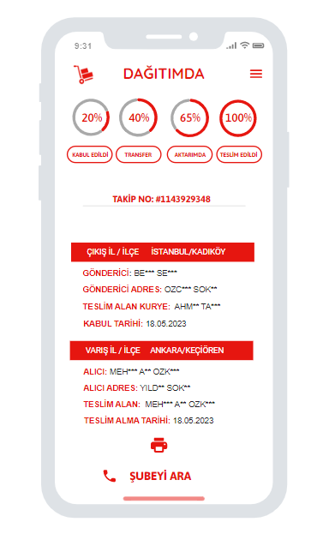
Shipping Information Page
From here, the customer has information about where and in which process the cargo is.
SELECT ** FROM Ca bmCargo_db. Time-Info WHERE `TimeID ` == (user’s input from previous page);
SELECT SenderName , SenderSurname, SenderAddress , ReceiverName , ReceiverSurname, ReceiverAddress * FROM Ca bmCargo_db.Customer-Info WHERE `CustomerID ` == (user’s input from previous page);
SELECT BranchPhoneNumber* FROM Ca bmCargo_db.Branch-Info WHERE `BranchID ` == (user’s input from previous page);
Using the tracking number of the cargo , we transferred the information of the sender and the receiver , as well as information about the cargo and the branch contact information from bmcargo database to the user interface.
From here, the customer can print the cargo information and contact the courier by calling the customer service.

Slide 5
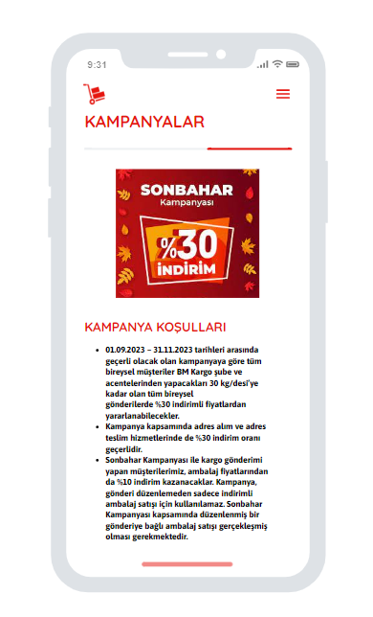
Campaign Page
From here, short and quick access to other pages is provided.
SELECT ** FROM Ca bmCargo_db. Campaigns ;
Information about the campaigns entered to bm cargo database by employees and the campaigns can display in the campaigns section of the mobile application.

Slide 6
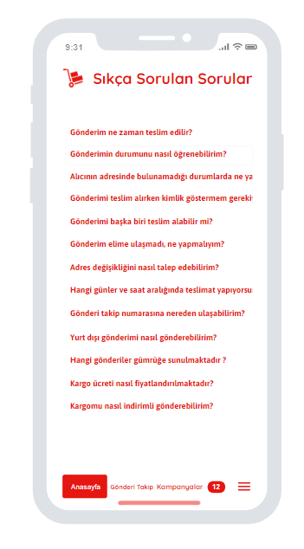
SSS Page
When the customer clicks on the question, the answer to the question drop down.
SELECT Sss* FROM CbmCargo_db.Cargo-Info ;
We show the answers to the frequently asked questions from the customers in the FAQ section.
From here, short and quick access to other pages is provided.

Slide 7
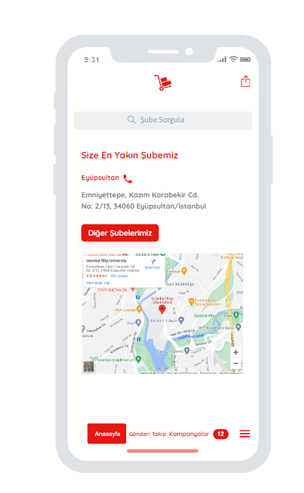
Nearest Branch Page
From here the customer can share the location of branch with other people.
The customer enters the location from here and sees the list of whether there is a branch there.
SELECT ** FROM Ca bmCargo_db.Branch-Info WHERE `BranchAddress ` == (user’s input);
In this user interface, we aim to show the branch name, address and contact information to the customer.
When the customer clicks on button and phone icon , they can call branch or see other branch locations.
SELECT BranchPhoneNumber* FROM Ca bmCargo_db.Branch-Info WHERE `BranchID ` == (user’s input );
SELECT BranchName,BranchPhoneNumber FROM Ca bmCargo_db.Branch-Info WHERE `BranchAddress ` == (user’s input);
From here, short and quick access to other pages is provided.

Slide 8
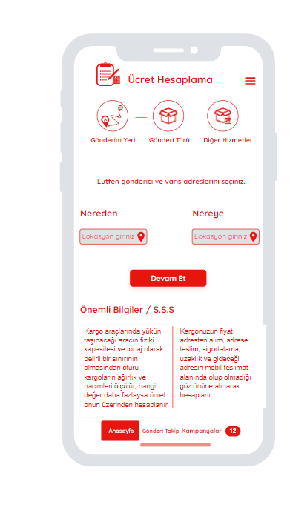
Fee Calculation Page
From here, short and quick access to other pages is provided.
From here, the customer chooses situations such as bringing the cargo to the branch herself or receiving it from the courier's home, and these are recorded in the database.
SELECT BranchDelivery FROM CbmCargo_db.Delivery-Type;
SELECT (c.SenderAddress - b.BranchAddress) AS Distance , cc.PaymentAmount* FROM CbmCargo_db.Customer-Info c , bmCargo_db.Branch-Info b , bmCargo_db.CargoCost cc WHERE Distance == cc.PaymentDistance;
Here, the payment amount is determined according to the distances, so we show the customer the prices in the database with the distance entered by the user.
SELECT Sss* FROM CbmCargo_db.Cargo-Info ;
From here, short and quick access to other pages is provided.

Slide 9
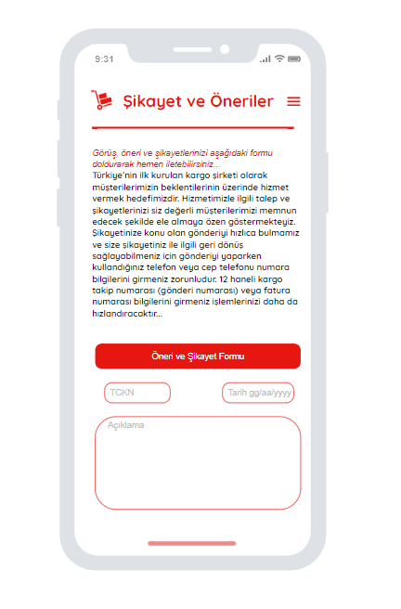
Complaint Page
INSERT INTO Complaint-Info(ComplaintDate,ComplaintDescription,SenderTC)
VALUES (user input);
The information entered by the customers is saved in the database and thus bm cargo aims to provide a better service.

Slide 10
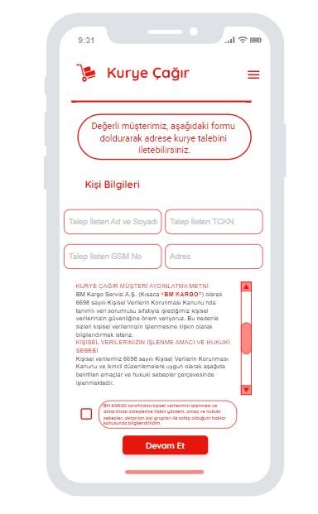
Call a courier
INSERT INTO Customer-Info(SenderName,SenderSurname,SenderTC,SenderAddress)
VALUES (user input);
The information entered by the customers is recorded in the database, the remaining information is taken by the courier . Then the courier receives the cargo to make remaining process.

Slide 11
Thank you

